Slide 1
UNIT I
Introduction

Slide 2
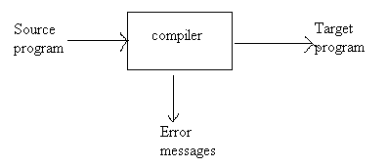
Language Processors:
Compiler: A compiler is a program that can read a program in one language (source language) and translate it into an equivalent program in another language (target language).

Slide 3
Language Processors:
Interpreter: An interpreter is another common kind of language processor. Instead of producing a target program as a translation, an interpreter appears to directly execute the operations specified in the source program on inputs supplied by the user.
The machine-language target program produced by a compiler is usually much faster than an interpreter at mapping inputs to outputs.
An interpreter, however, can usually give better error diagnostics than a compiler, because it executes the source program statement by statement.

Slide 4
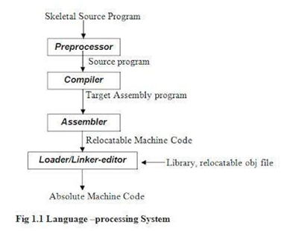
Language Processors:
A language-processing system typically involves – preprocessor, compiler, assembler and linker/loader – in translating source program to target machine code.

Slide 5
The Analysis-Synthesis Model of Compilation:
There are two parts to compilation
Analysis
Synthesis
Analysis: The analysis part breaks up the source program into constituent pieces and creates an intermediate representation of the source program.
Synthesis: The synthesis part constructs the desired target program from the intermediate representation.

Slide 6
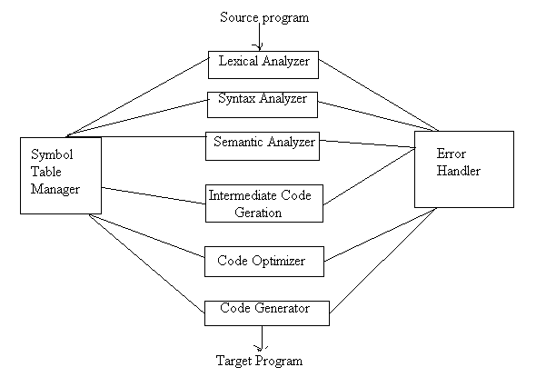
The Phases of a Compiler:

Slide 7
The Phases of a Compiler:
The compiler implementation process is divided into two parts.
Analysis of source program
Lexical analysis
Syntax analysis
Semantic analysis
Synthesis of target program
Intermediate code generation
Code optimization
Code generation

Slide 8
The Phases of a Compiler:
Lexical Analysis:
The lexical analysis phase reads the character in the source program and groups them into a stream of tokens.
The lexical analysis, not only recognizes tokens but also the code value for that tokens.
E.g. position:= initial + rate * 60
Would be grouped in to the following tokens.
Position identifier
:= assignment
Initial identifier
+ plus sign
Rate identifier
‘*’ multiplication sign
60 constant.

Slide 9
The Phases of a Compiler:
Syntax Analysis:
Hierarchical analysis is called parsing or syntax analysis.
Function of Syntax Analysis:
It first checks for the tokens given by lexical analysis whether they are permitted by the specification of the source language.
It constructs a tree structure of the incoming token stream by identifying which parts of the token stream should be grouped together and known as parse tree of tokens.

Slide 10
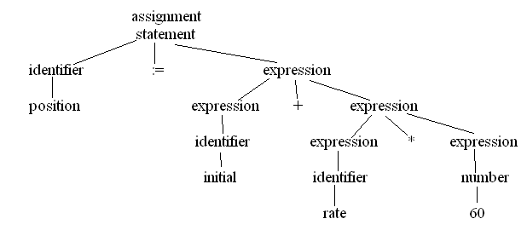
The Phases of a Compiler:
Parese Tree

Slide 11
The Phases of a Compiler:
Semantic Analysis:
Checks the source program for semantic errors and gathers the information for the subsequent code generation phase.
An important component of semantic analysis is type checking.

Slide 12
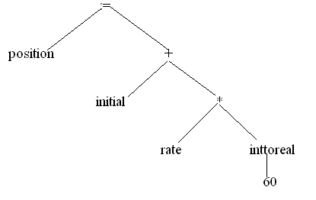
The Phases of a Compiler:
Syntax Tree

Slide 13
The Phases of a Compiler:
Intermediate Code Generation:
Transforms the parse tree into an intermediate language representation of the source program.
Different forms of intermediate language
Post-fix Notation
Three address statements
Syntax Tree & DAG

Slide 14
The Phases of a Compiler:
Three Address Statements:
temp1:= inttoreal(60);
temp2:=id3 * temp1;
temp3:= id2+ temp2;
id1:= temp3;

Slide 15
The Phases of a Compiler:
Code Optimization:
The code optimization phase attempts to improve the intermediate code, so that faster running machine code will be produced.
Optimization is done in two ways.
Local optimization
Loop optimization
Eg: temp: = id3 * 60.0
id1:= id2 +temp1

Slide 16
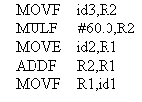
The Phases of a Compiler:
Code Generation:
Consisting normally of relocatable machine code or assembly code.
Memory locations are selected for each of the variables used by the program.
Then intermediate instructions are each translated into a sequence of machine instructions that perform the same task.

